Slide 1

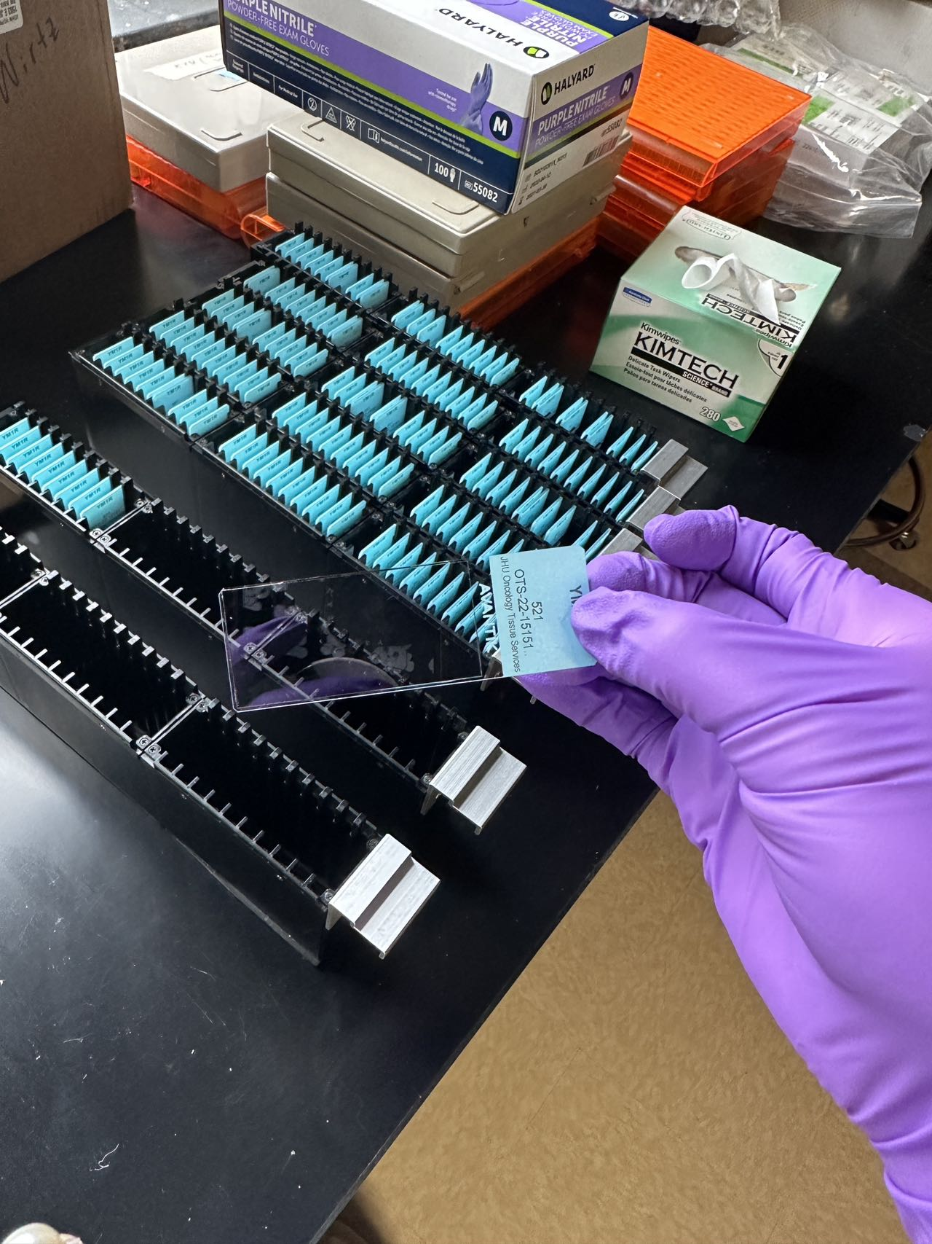
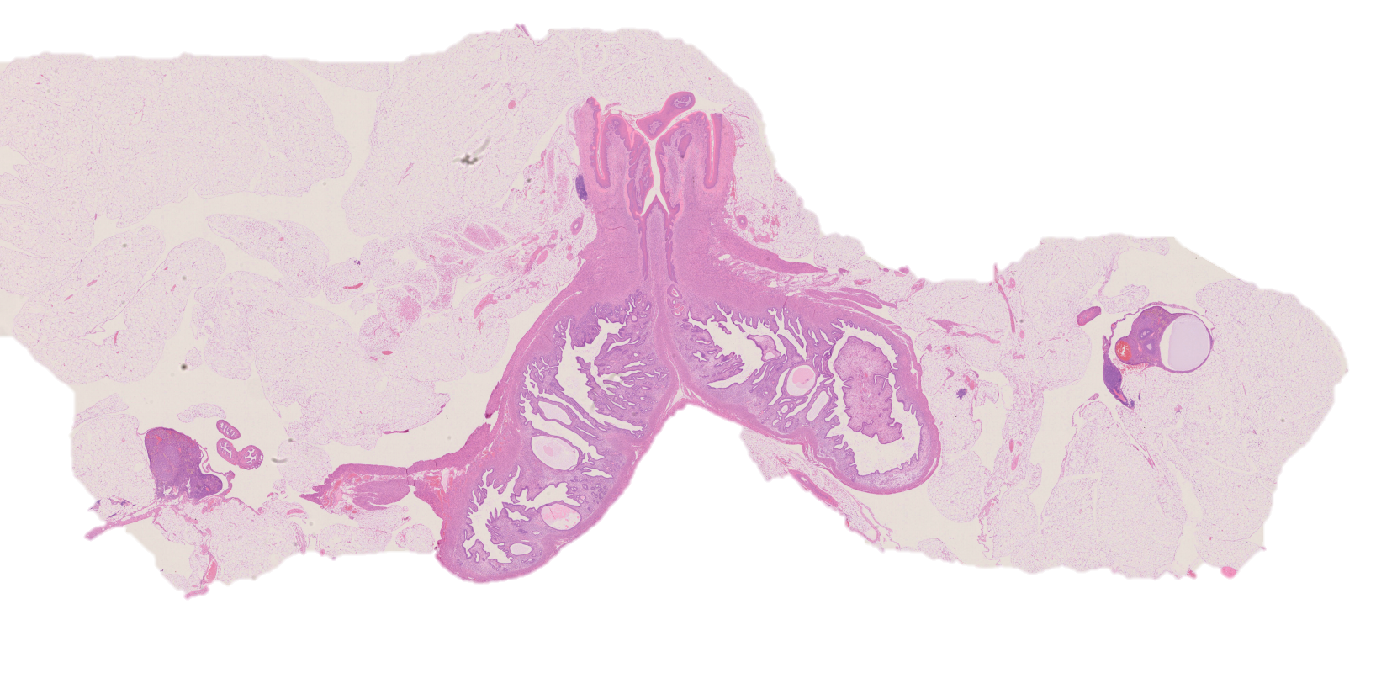
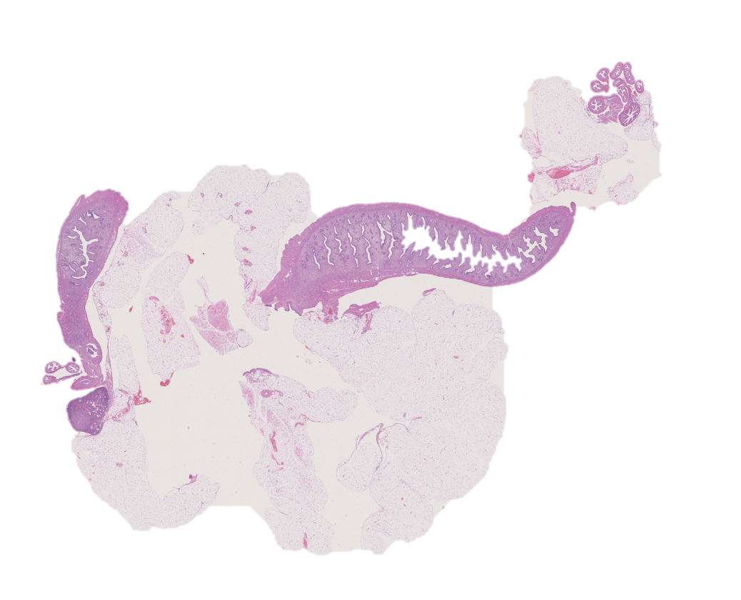
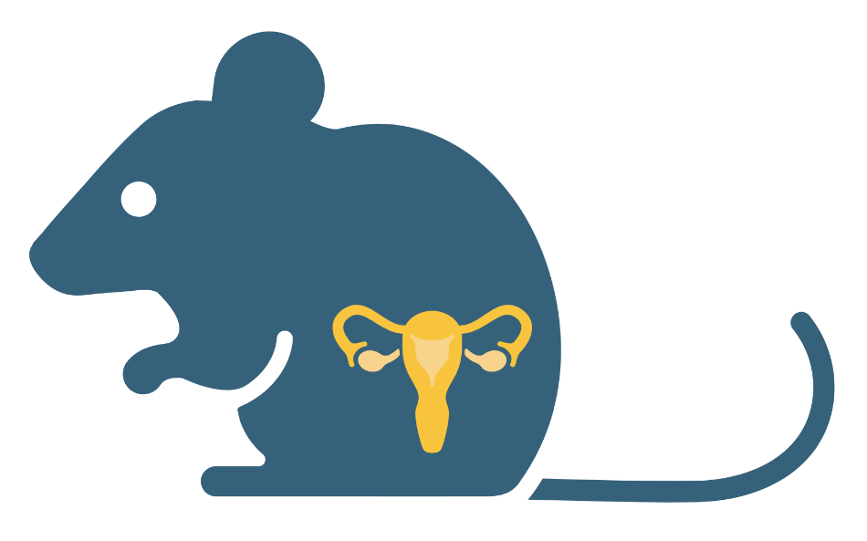
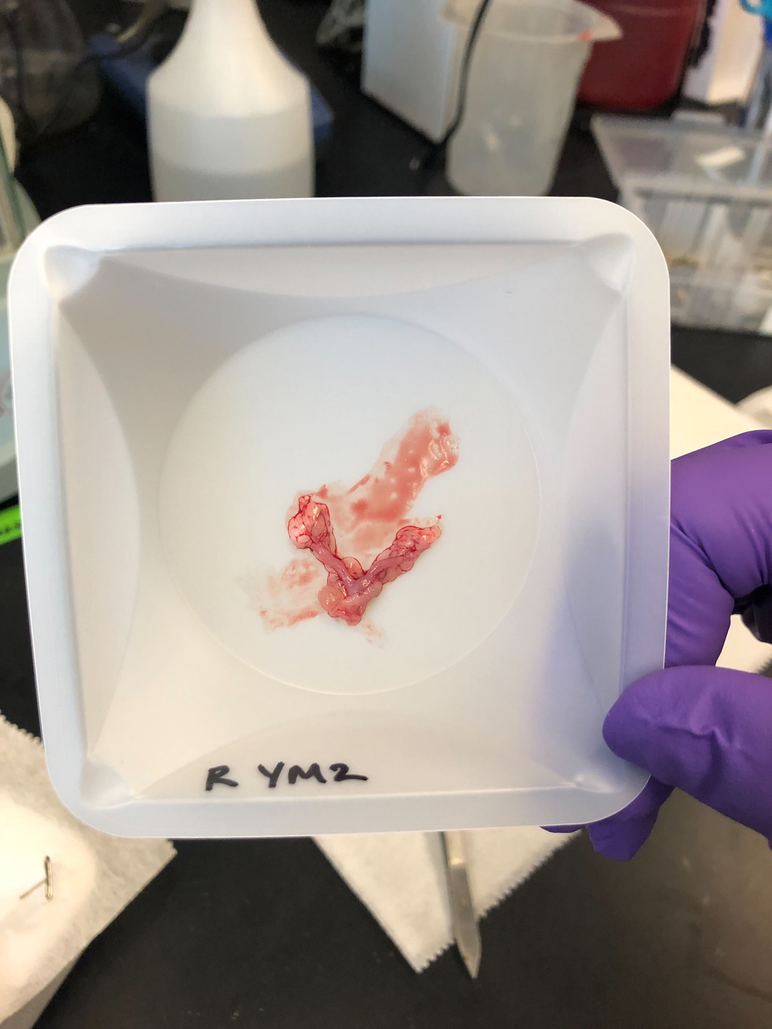
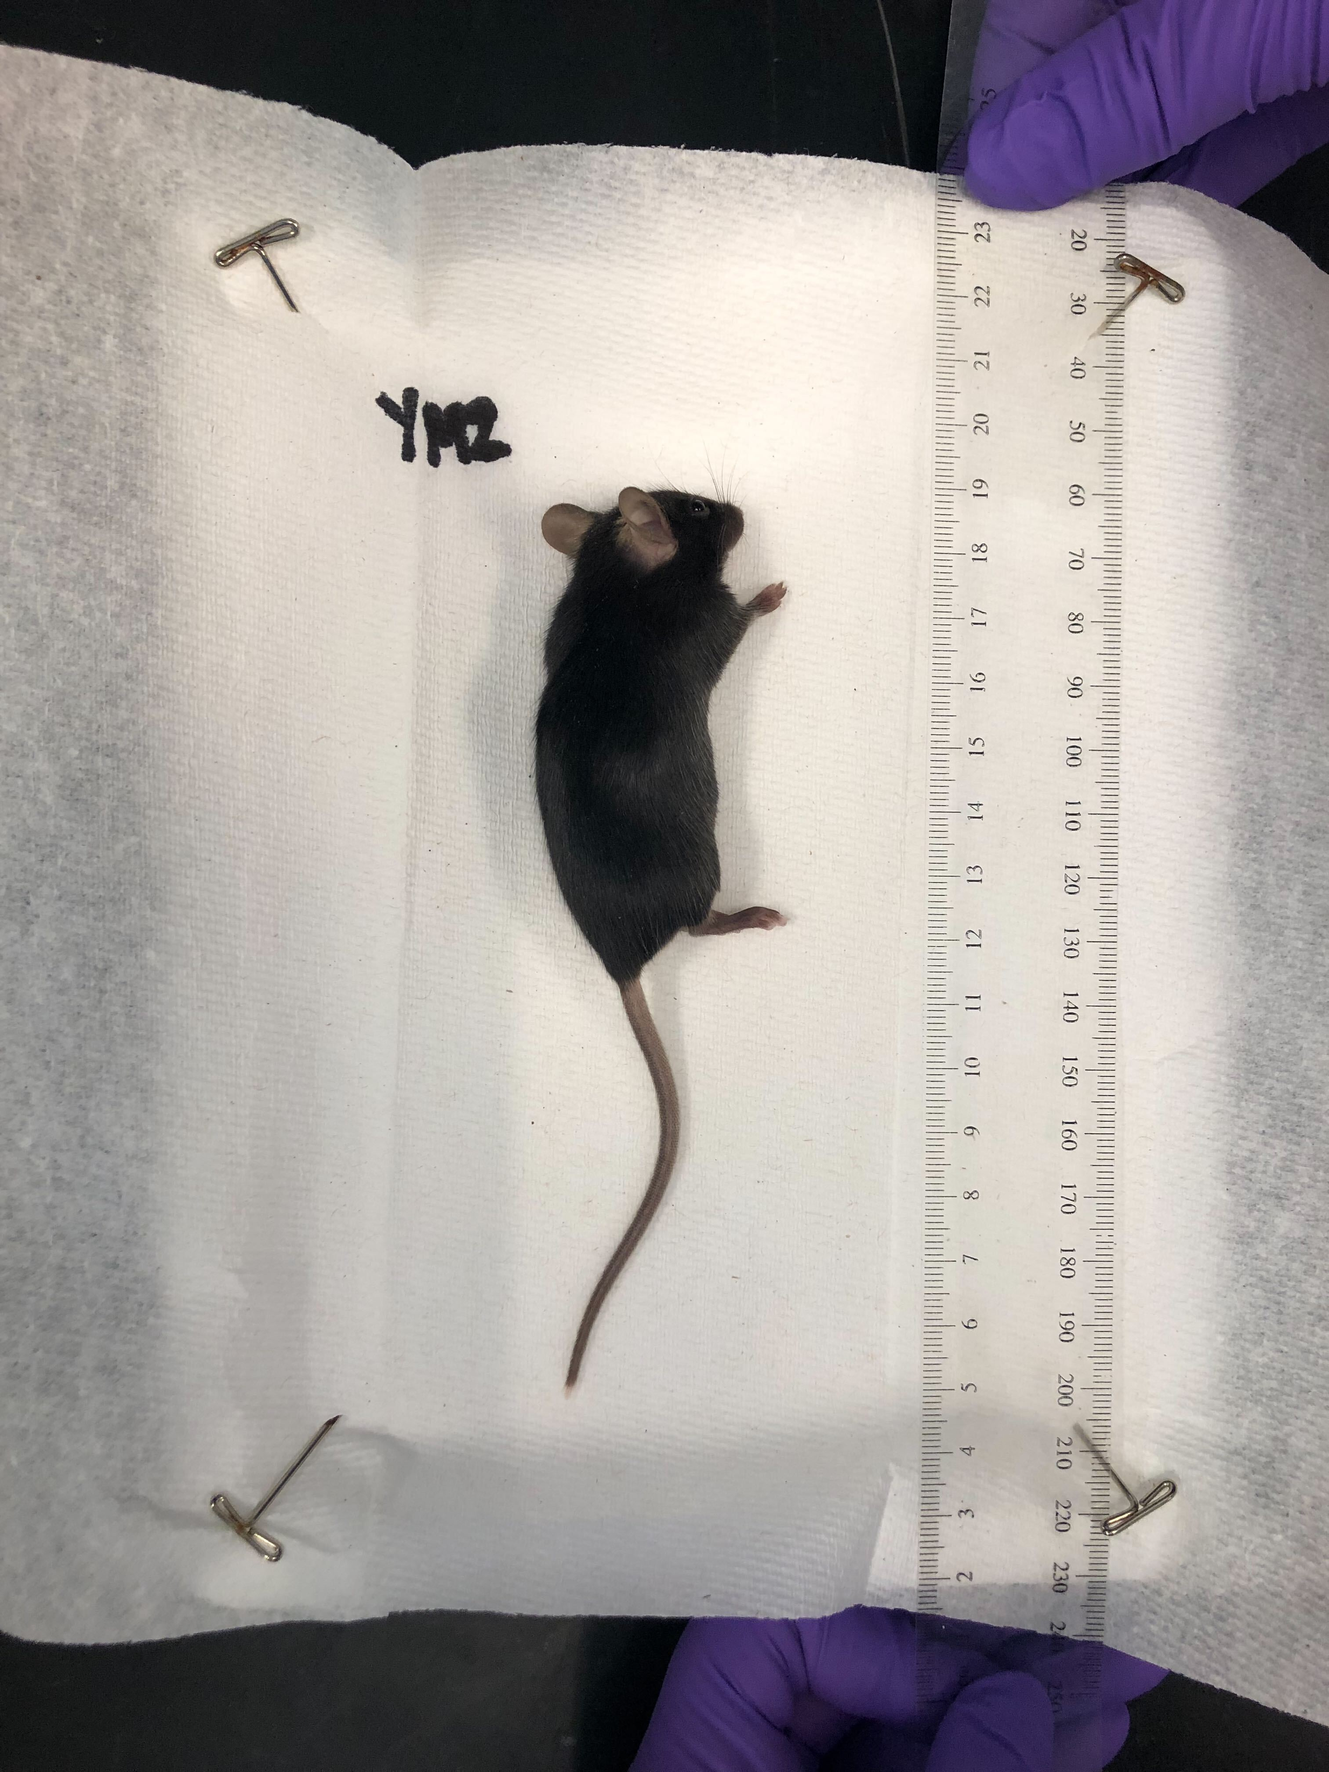
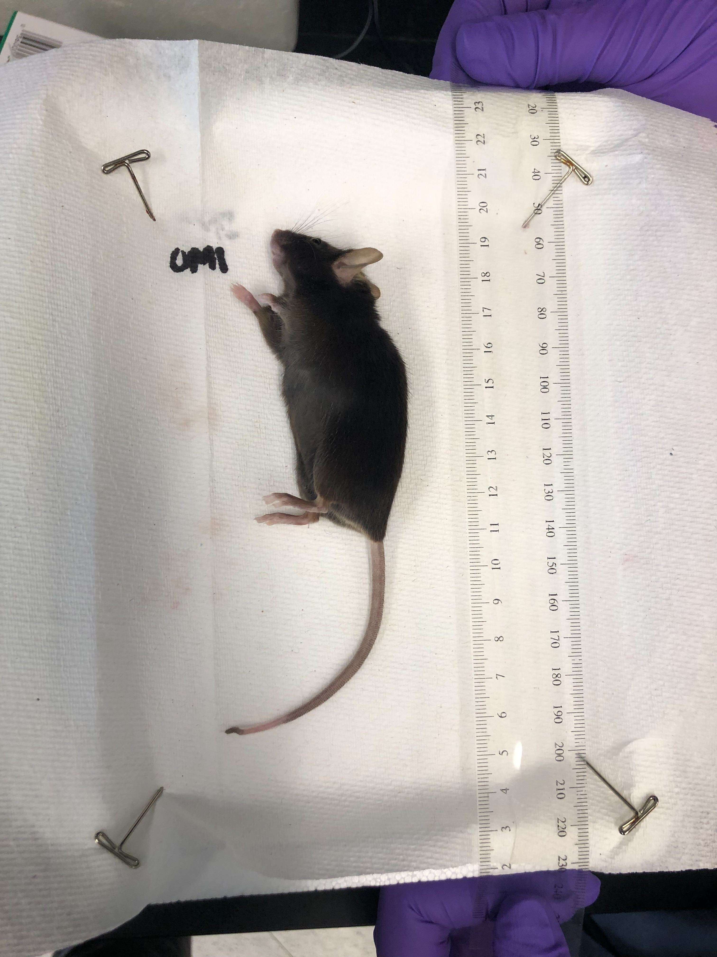
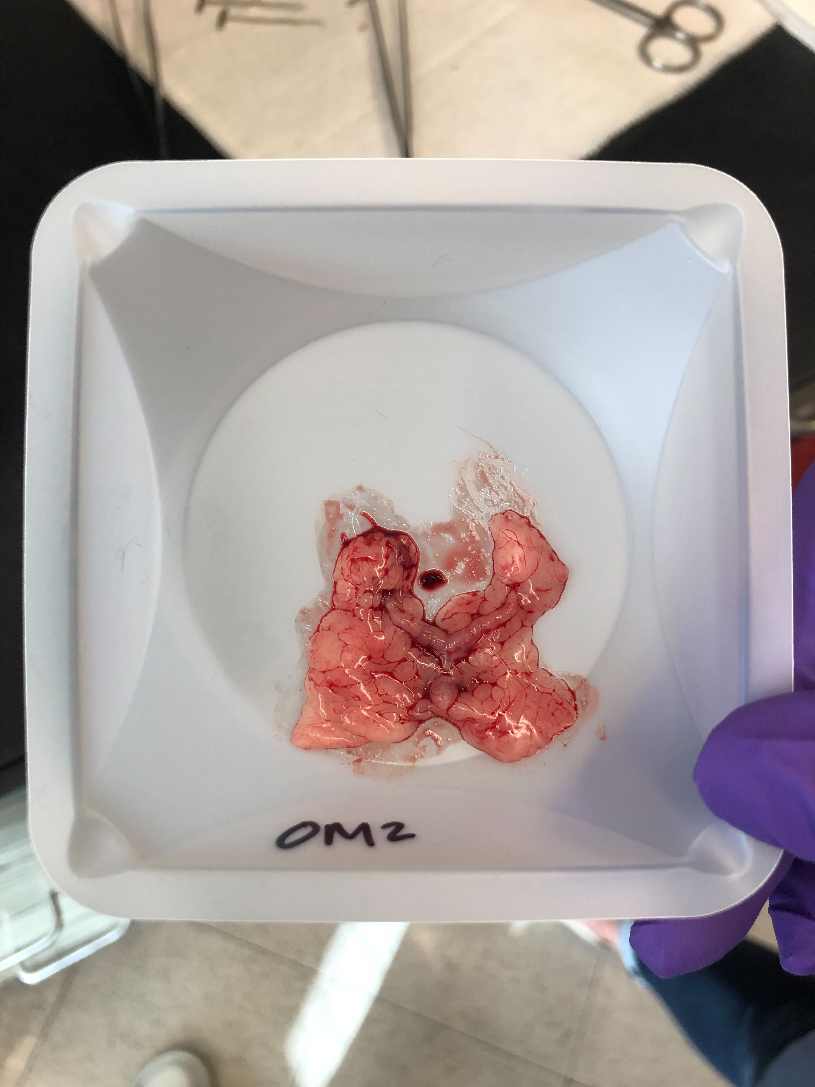
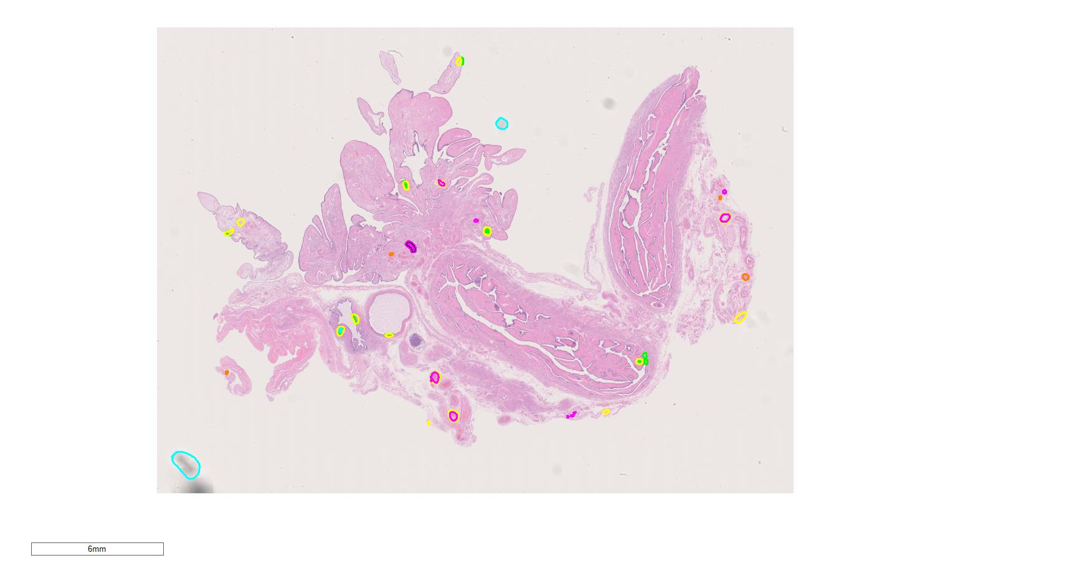
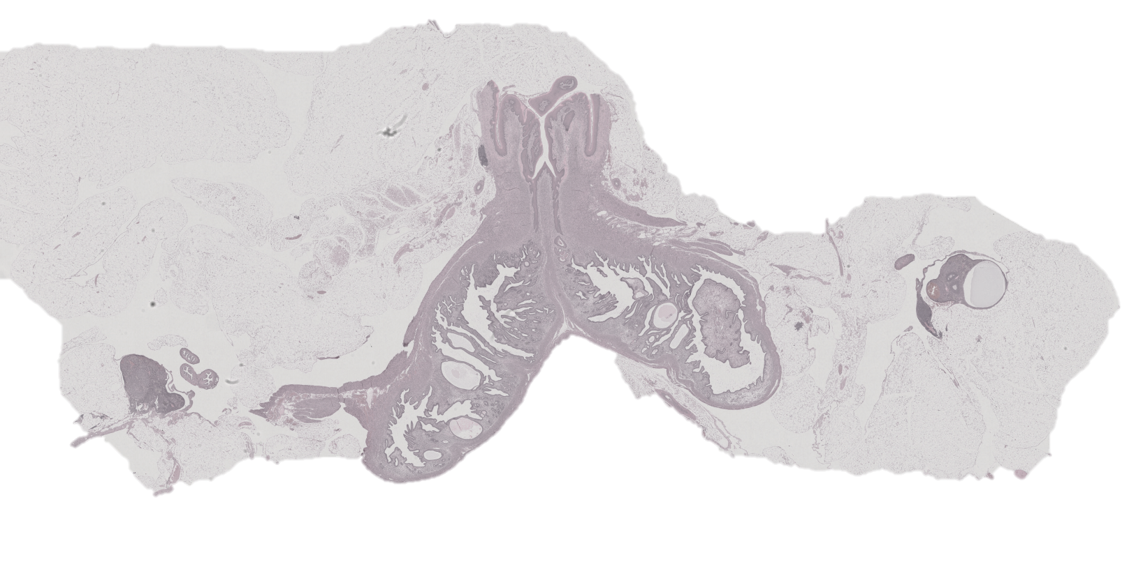
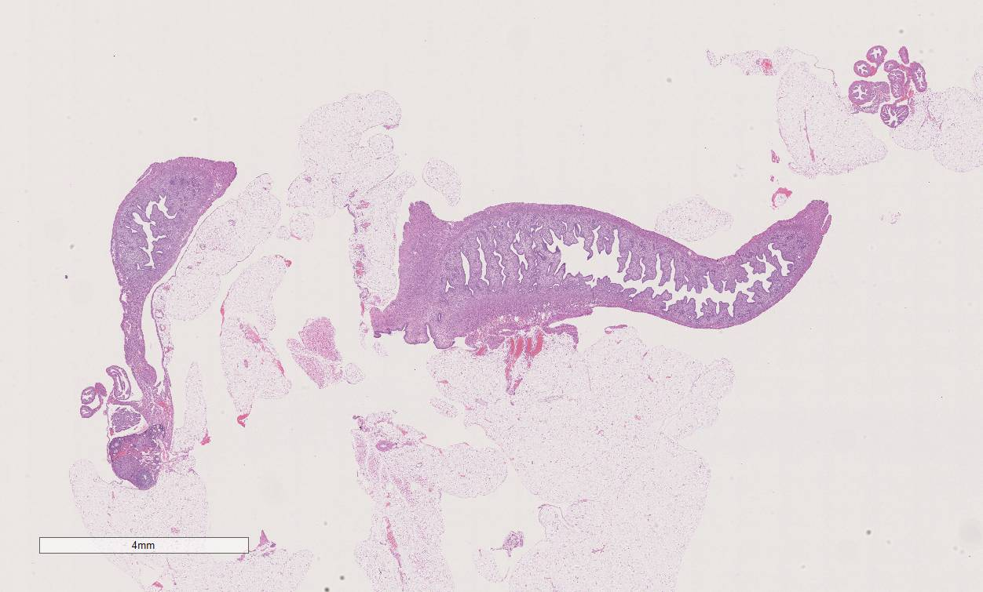
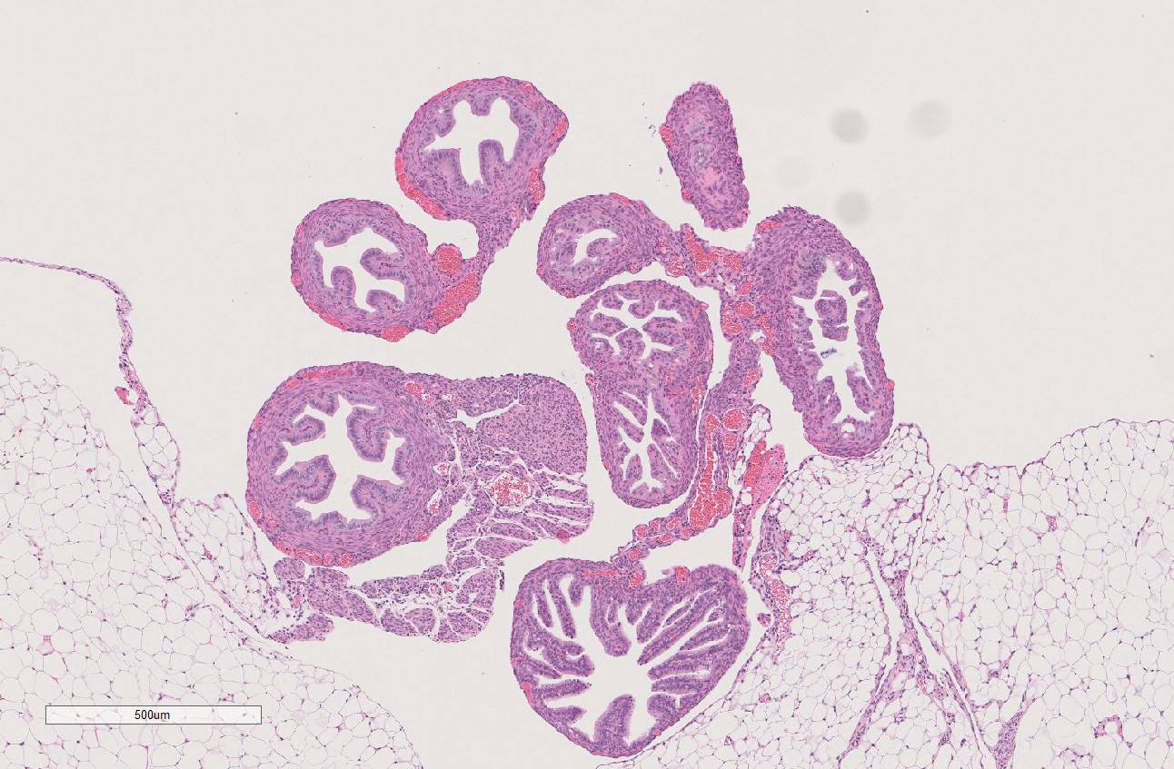

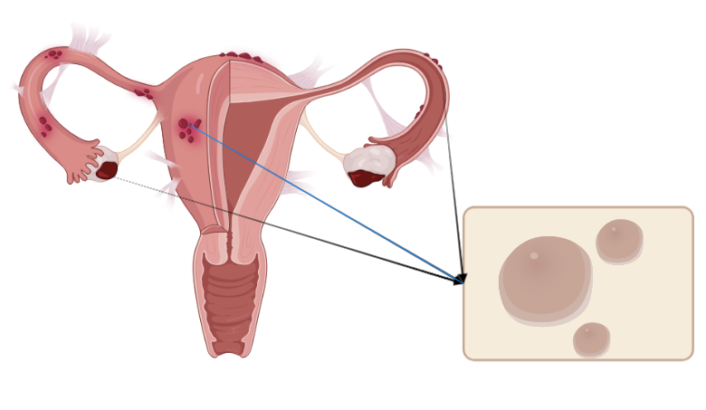
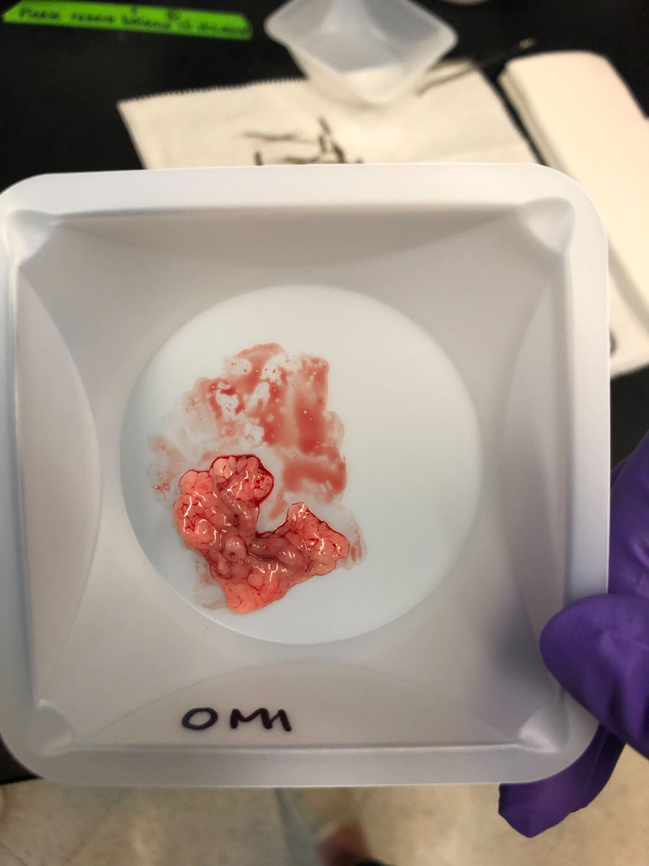
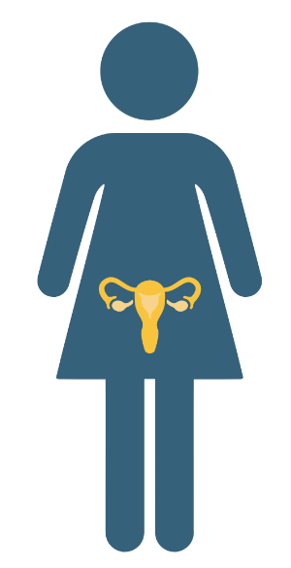


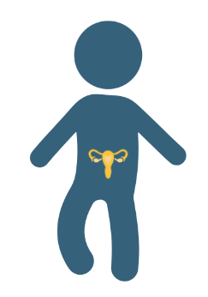
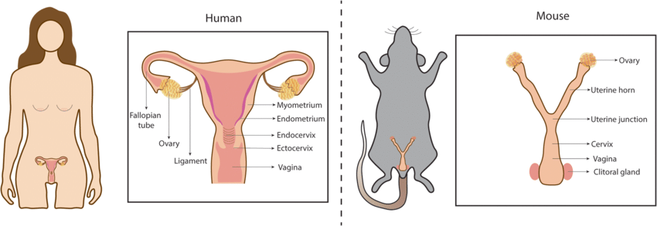
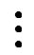
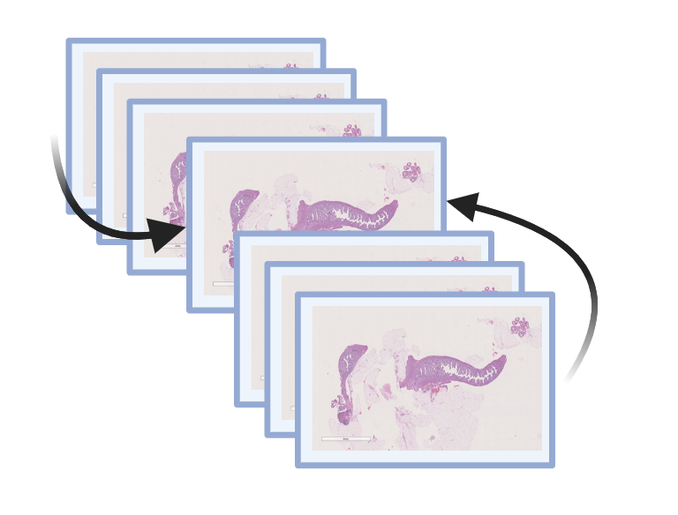
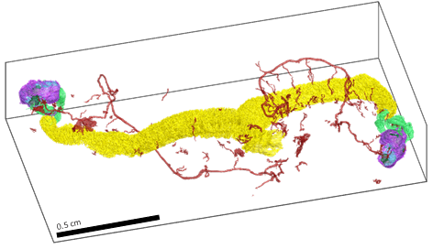

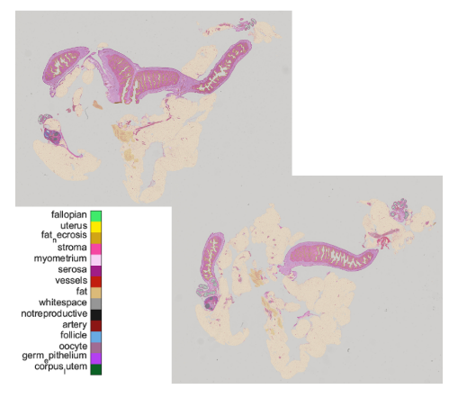
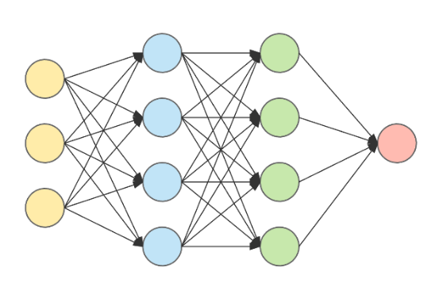
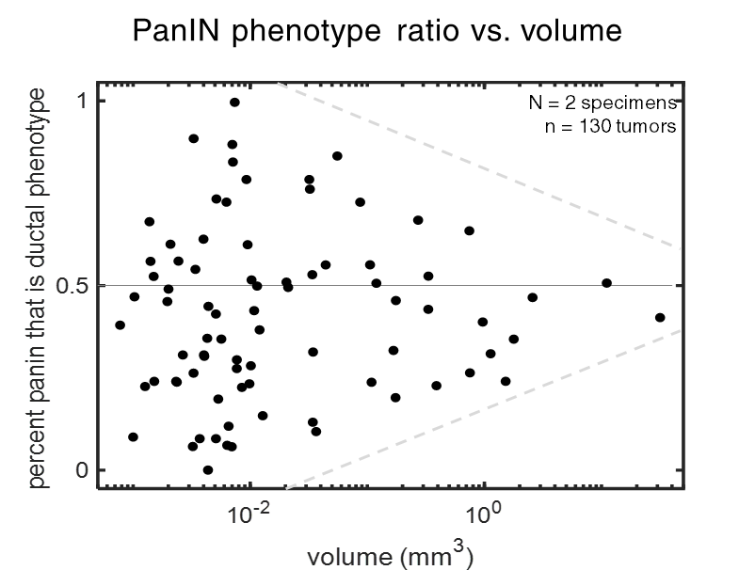
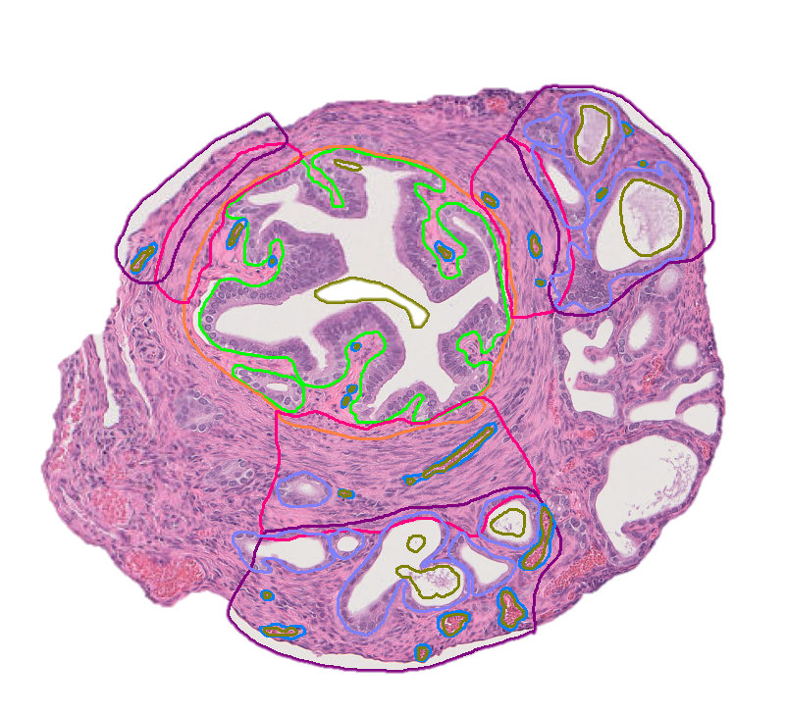
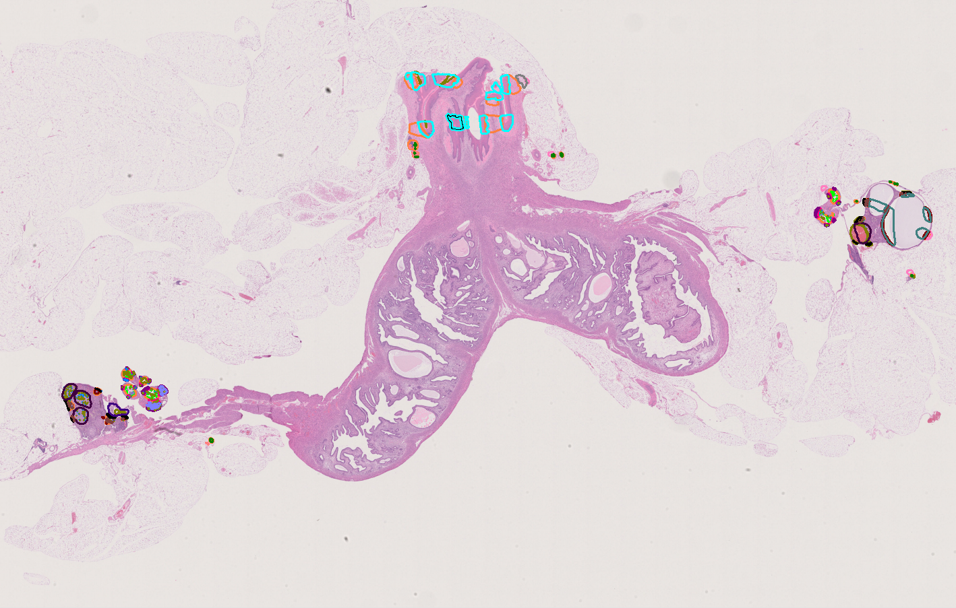
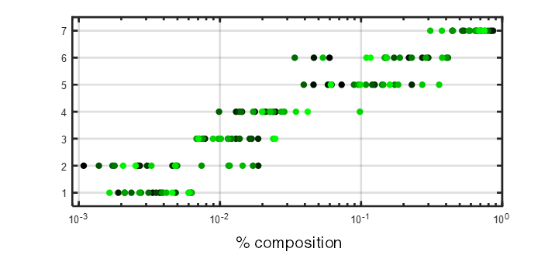
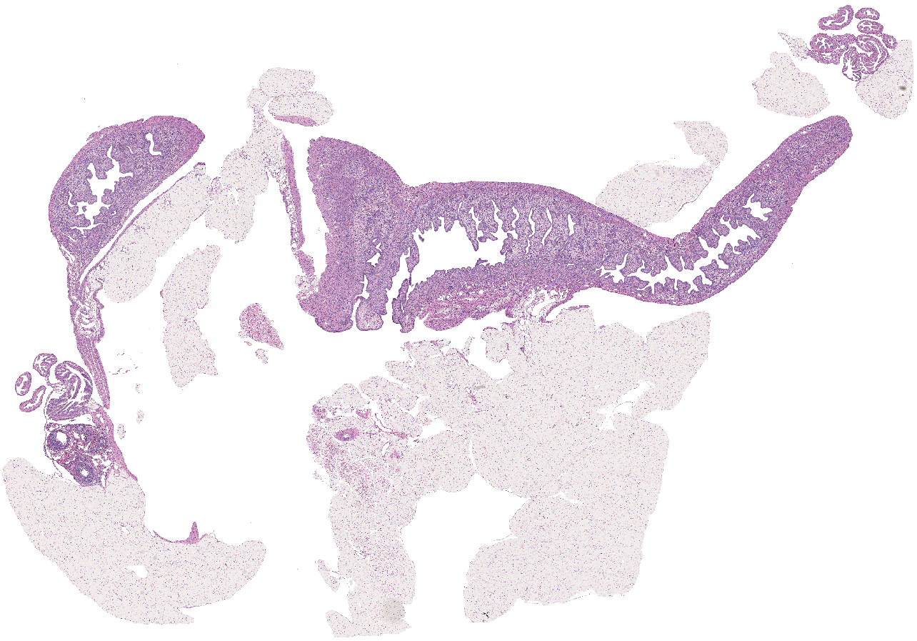
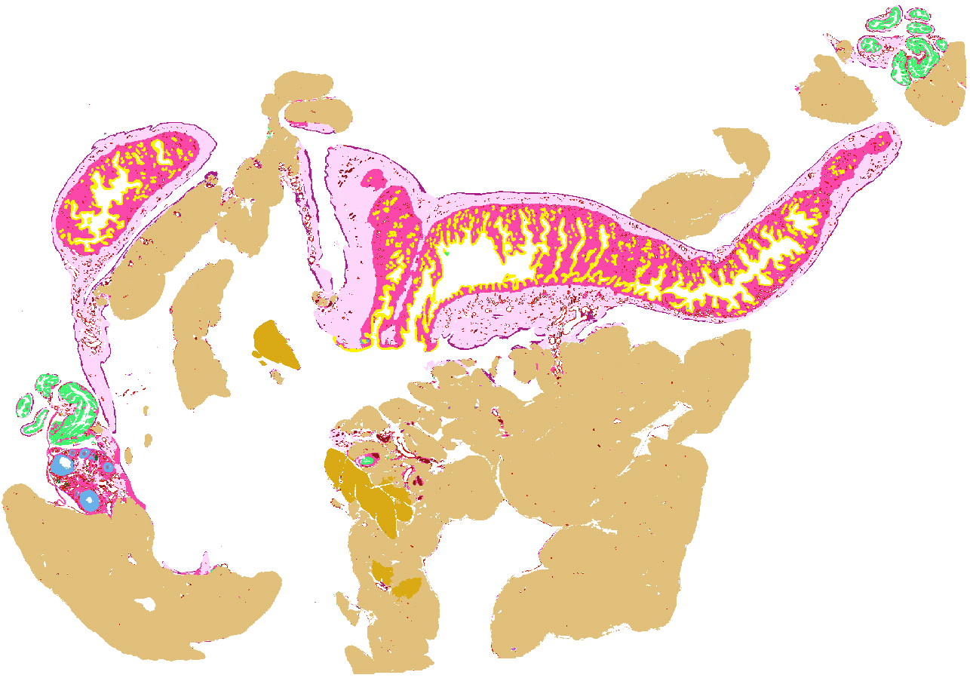
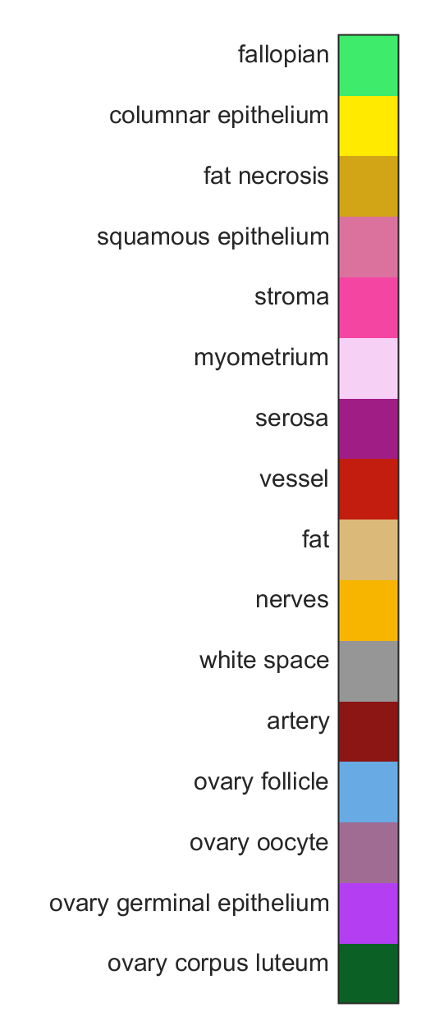
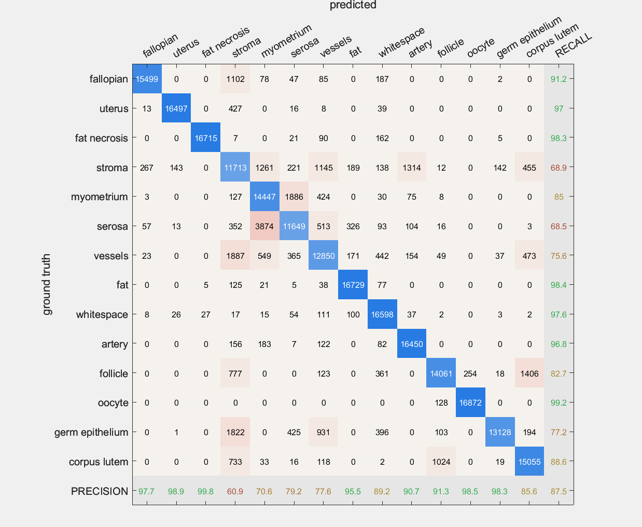
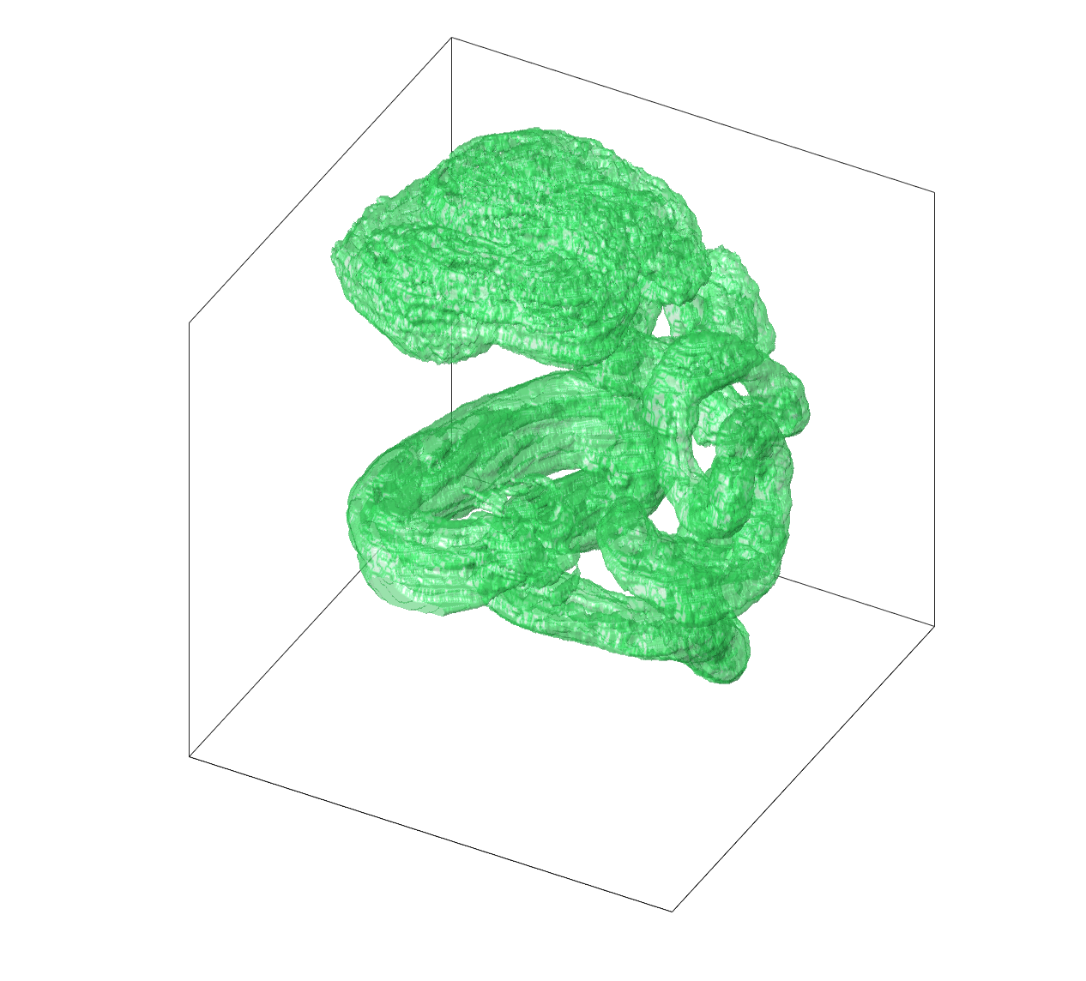
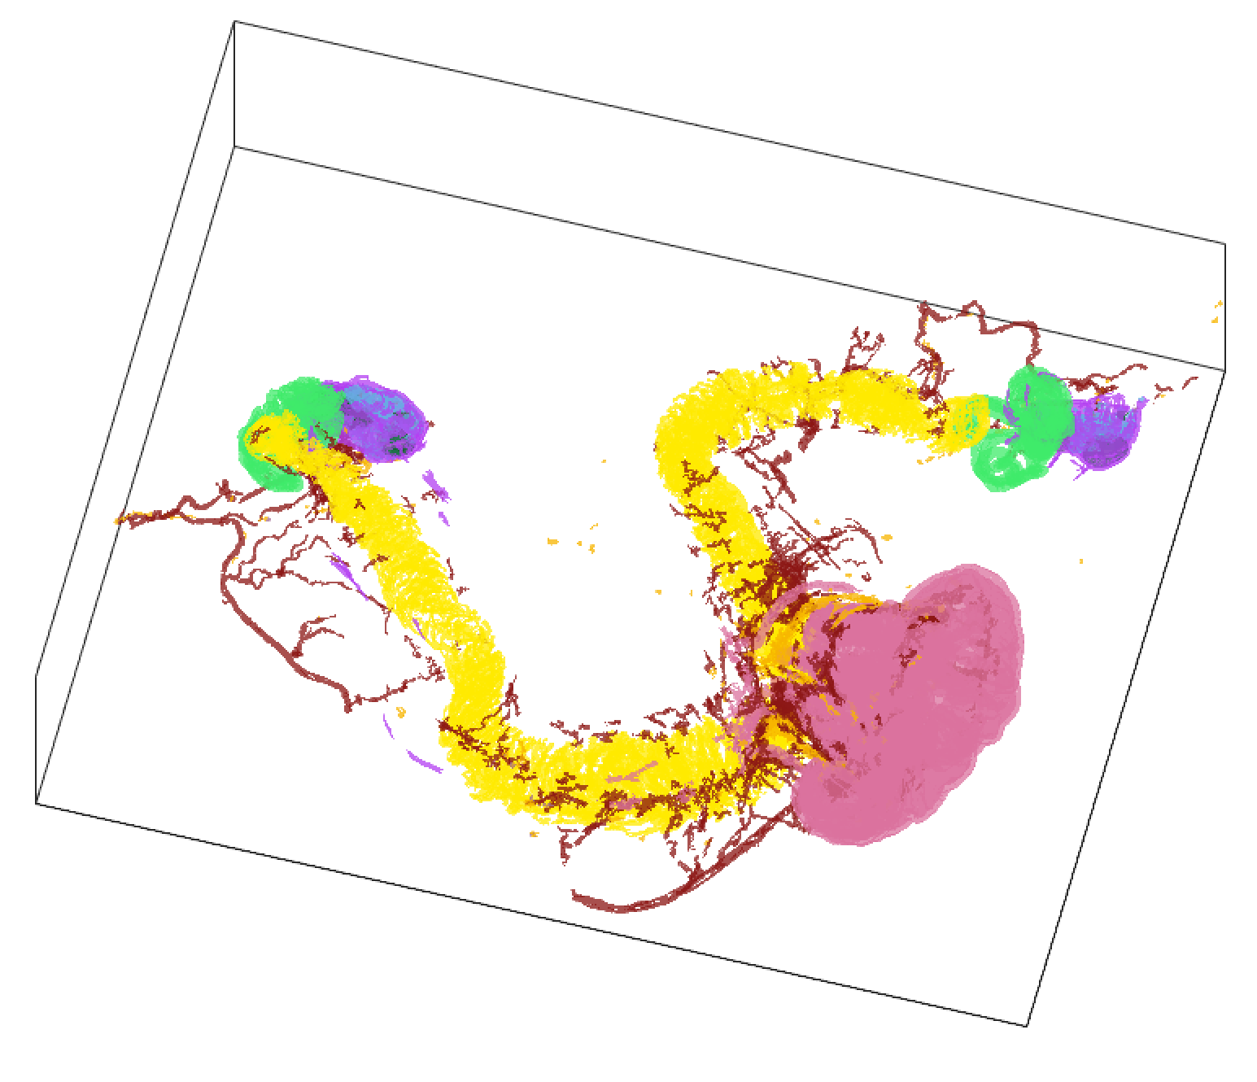
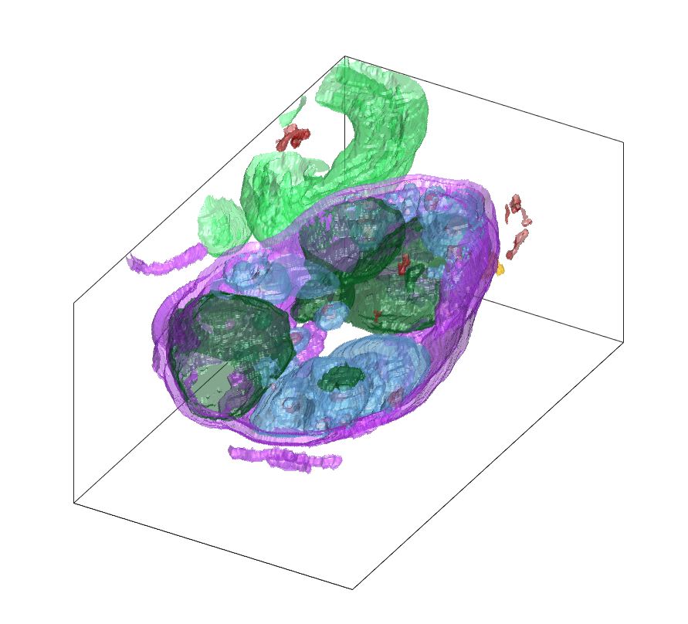
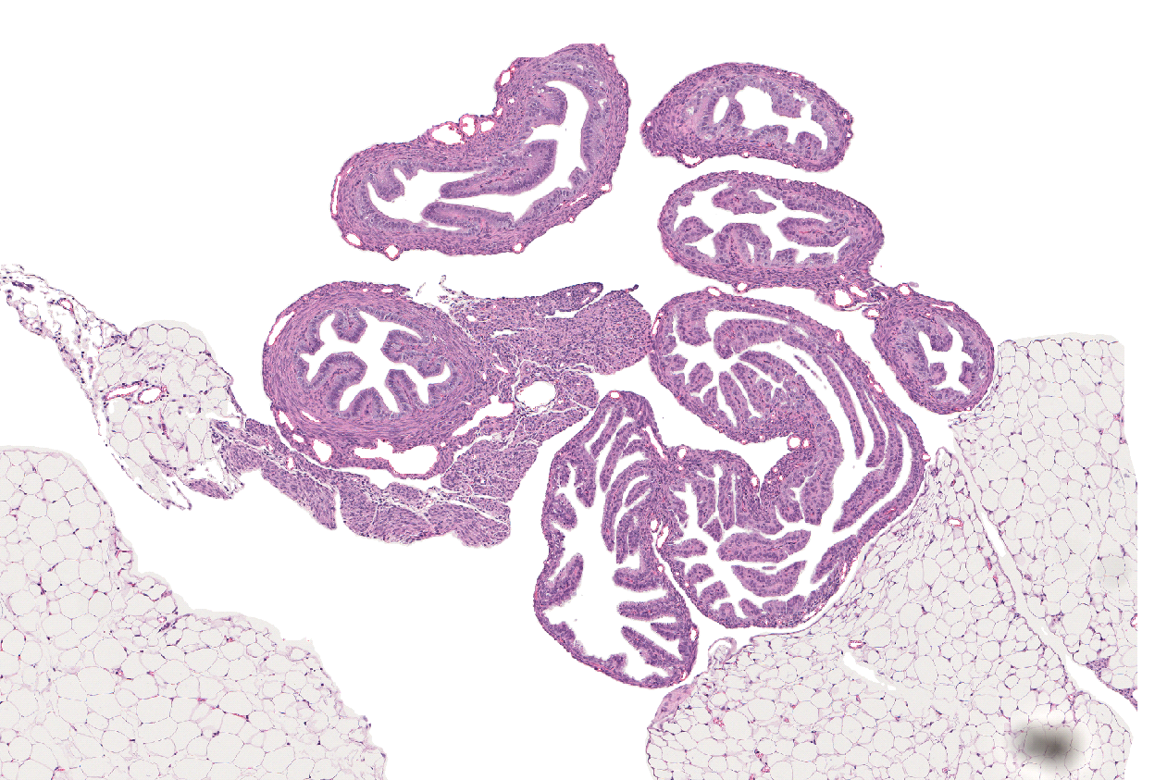
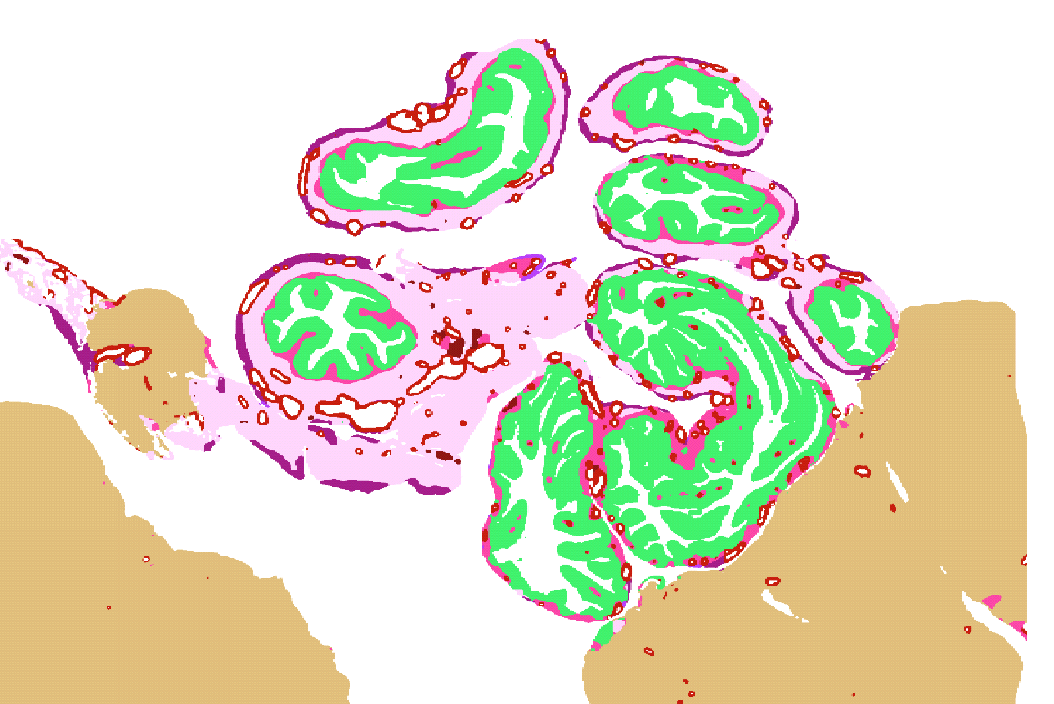
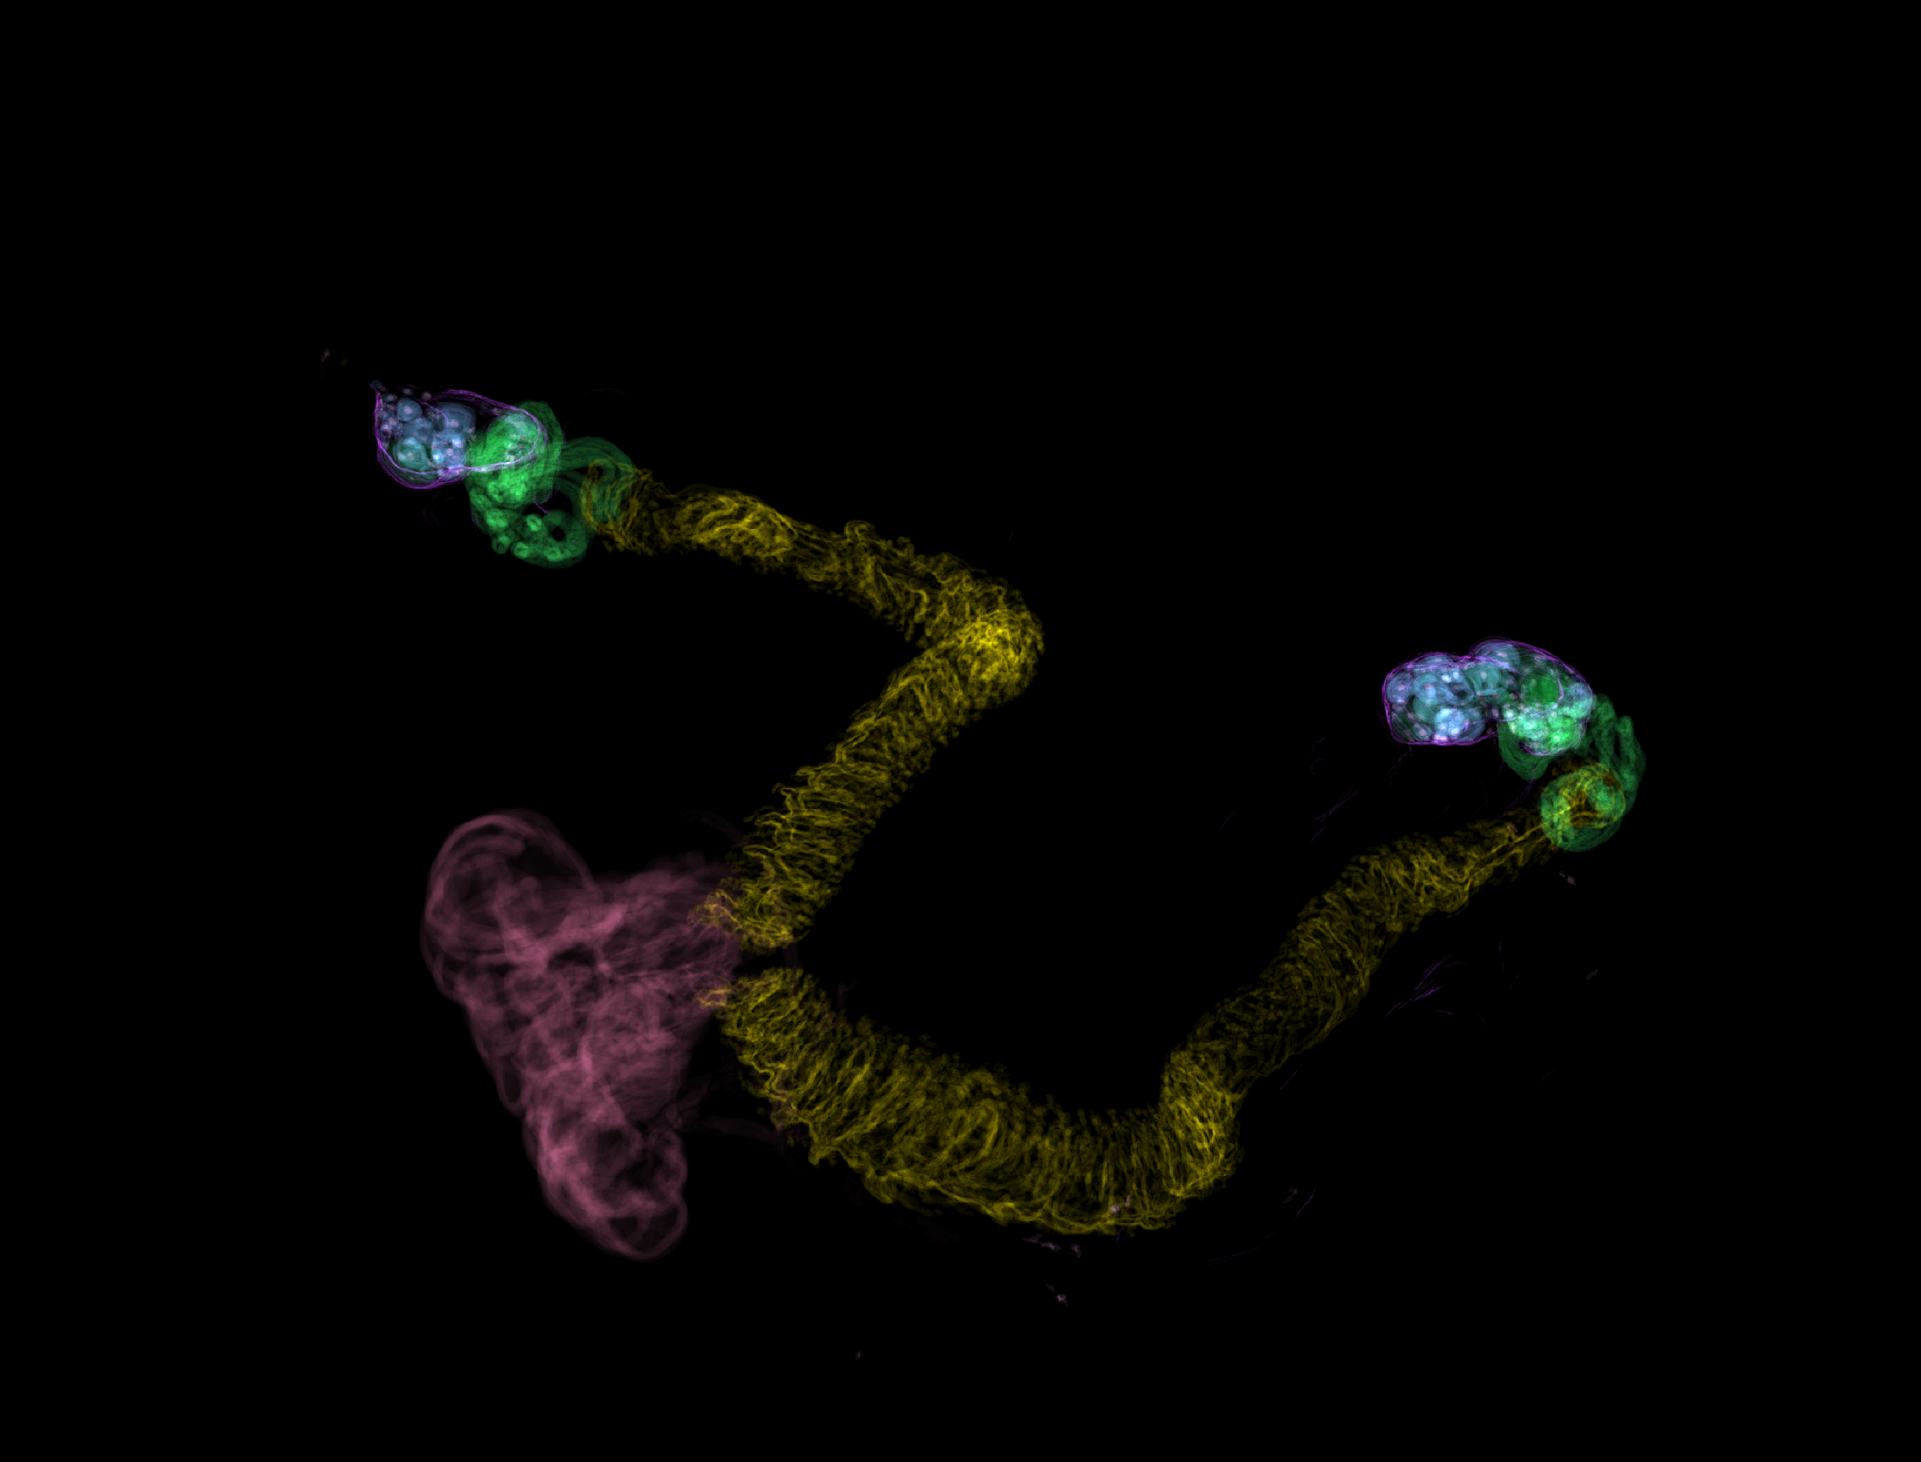
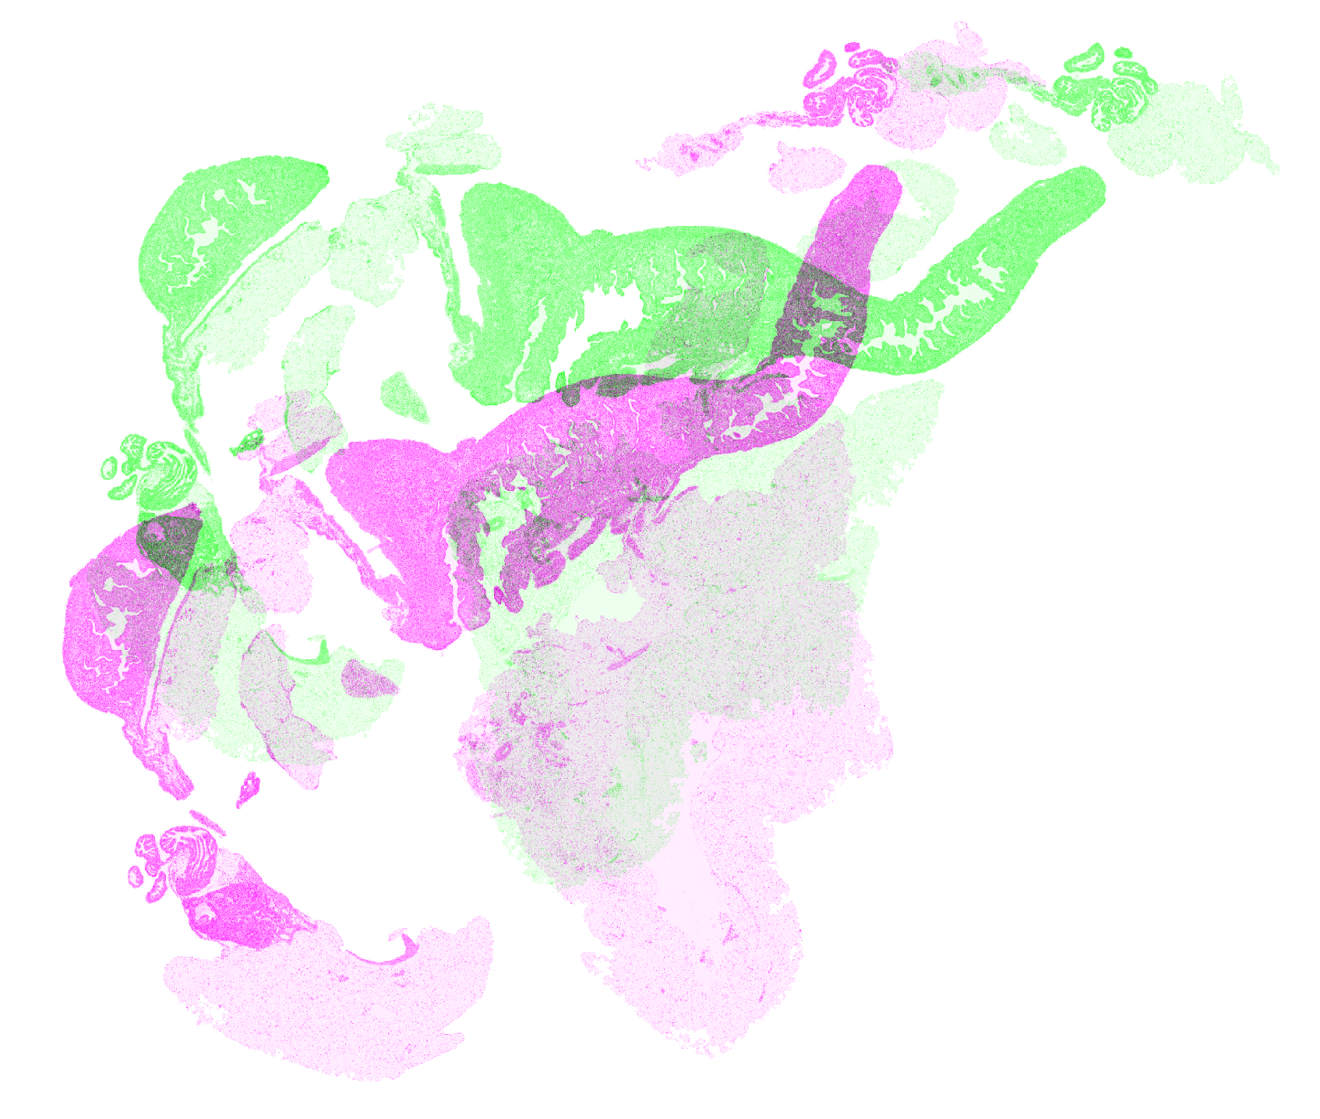
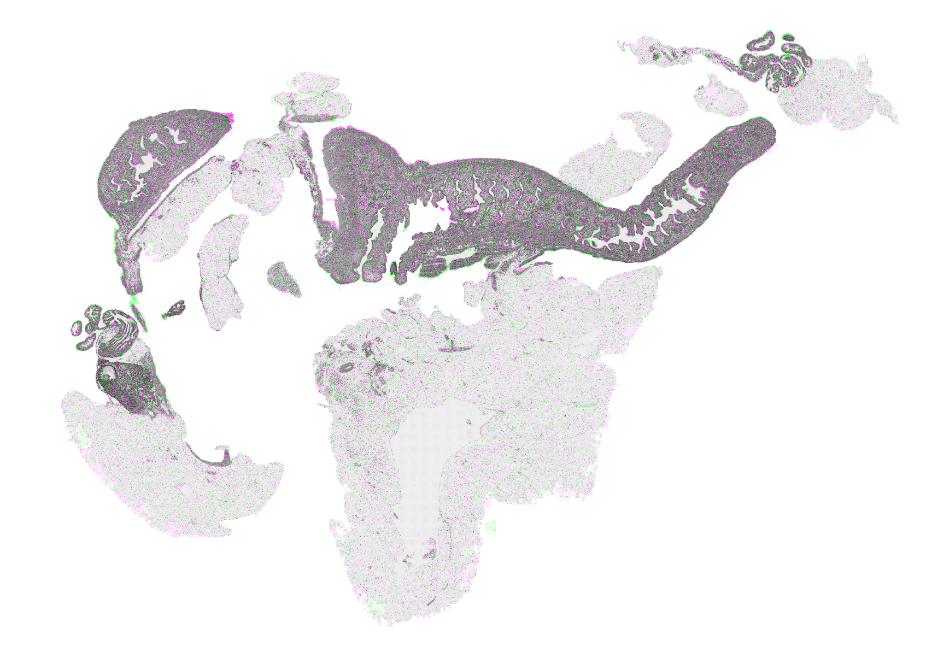
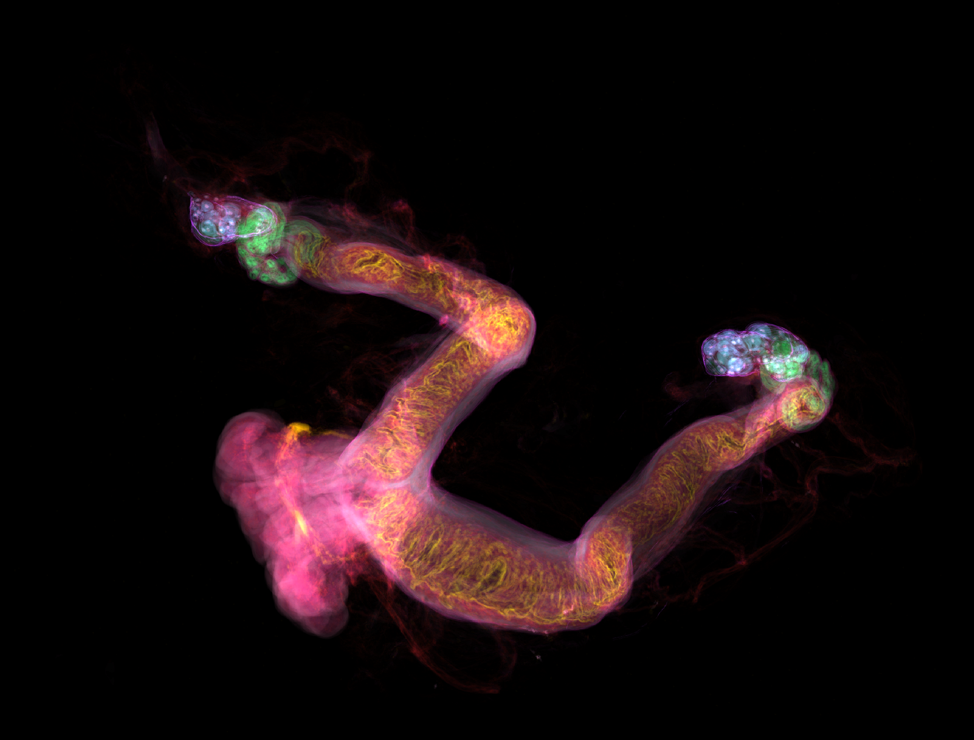


3D Reconstruction and Multi-Organ Mapping of the Female Mouse Reproductive System as a Function of Age
Yutong(Irina) Zhu¹, Mia Grahn¹, Aanya Kheterpal², Ashleigh Crawford¹, Denis Wirtz¹, Ashley L. Kiemen²
Department of Chemical and Biomolecular Engineering, Baltimore, MD
Department of Pathology, Johns Hopkins University, Baltimore, MD
Motivation
Materials and Methods
Advanced maternal age is associated with infertility and a higher risk of experiencing adverse health complications. Menopause is a significant indicator of aging. After menopause, the uterus, fallopian tubes, and ovaries start to become smaller. Additionally, the vaginal wall, cervix, and uterine muscles tend to become looser due to the loss of muscle content. What’s worse?, the accumulation of scarring and inflammation increases the likelihood of developing ovarian cysts, uterine fibroids, fallopian tube blockage, and raises the risk of gynecological cancers. These factors collectively contribute to the challenges faced by women as they age [1].
One common issue in the female reproductive system is the development of cysts, and cancerous cysts are more prevalent after menopause. Cysts can lead to health complications such as cyst rupture, ovarian torsion, abdominal or pelvic pain, vaginal discomfort, excessive bleeding, miscarriages, and infertility [2].
Conducting research on human reproduction presents challenges due to the complexities and limitations associated with investigating biological samples from women. On the other hand, the mouse model offers certain advantages in terms of accessibility and size, allowing for the exploration of interconnectivity between reproductive organs. Besides, studies have demonstrated that mouse models are crucial in uncovering patterns of cancer cell invasion and host immune responses in the reproductive system.
Timeline of mouse aging
Pups
0.5 month
Young adult
4 month
~Menopause
12 month
Old
20 month
Pups
Menopause
(9-12 months)
Geriatric (~22 months)
Human Fallopian Tube H&E Image (20x)
Mouse Reproductive System H&E Image (20X)
H&E (every 8 micron)
26 mm long
18 mm width
18 mm long
0.36 mm width
Unstained
H&E (every 8 micron)
Unstained
H&E (every 8 micron)
H&E staining, serial staining & digitization
Tissue acquisition
Objectives
Image processing & registration
Visualization & Quantification
Goal: Create 3D, multi-organ maps of the normal mouse reproductive system at a multi-cm³ scale to identify major changes to ovary, fallopian, cervix and vagina morphology and immune infiltration with age
Figure 1 - CODA Scheme
Previously developed by Kiemen et al [3].
Microanatomical labelling
Deep learning segmentation
Results
Future Directions
H&E image
Segmented image
Figure 4 – Three-dimensional Reconstruction Results
Illustration of the fully-labelled 3D volumes of a young mouse sample at single-cell resolution
Construct cellular-level 3D models of the mouse reproductive system at 4 different ages
Perform IMC/IHC-based analysis to quantitively examine change in tissue morphology and cyst development under aging effect
Further investigation and comparison with human reproductive tissue at corresponding tissue sections and ages
2 mm
2 mm
References
Reference
0.2 mm
0.2 mm
87.5
0.2 mm
[1] Glick I, Kadish E, Rottenstreich M. Management of Pregnancy in Women of Advanced Maternal Age: Improving Outcomes for Mother and Baby. Int J Womens Health. 2021 Aug 10;13:751-759. doi: 10.2147/IJWH.S283216. PMID: 34408501; PMCID: PMC8364335.
[2] Mobeen S, Apostol R. Ovarian Cyst. In: StatPearls. StatPearls Publishing, Treasure Island (FL); 2022. PMID: 32809376. [3] Kiemen, A. L. et al. CODA: quantitative 3D reconstruction of large tissues at cellular resolution. Nat. Methods 19, 1490–1499 (2022).
Figure 2 – Tissue Multi-labelling Results
Microanatomical components of the mouse reproductive system are reliably segmented and labeled by the deep learning model
0.2 mm
2 mm
Figure 3 – Image Registration Results
Images are aligned into a semi-continuous stack using global and elastic registration
Z-projections of the image stack
b.
2 mm
a.
b.
Total | Number
Fallopian tube | 2
Follicles | 56
Oocytes | 218
Corpus luteum | 98
 | Volume (mm^3) | Volume percentage(%)
Total | 50.5 | 100.0
Fallopian tube | 0.7 | 1.4
Fallopian tube 1 | 0.4 | 0.8
Fallopian tube 2 | 0.3 | 0.6
Columnar epithelium | 2.0 | 4.0
Squamous epithelium | 5.0 | 9.9
Follicles | 0.3 | 0.6
Oocytes | 0.0 | 0.0
Corpus luteum | 0.4 | 0.7
a.
Conclusion
Acknowledgements
Figure 5 – Quantitative Results
Initial quantitative results corresponds to literature review a. volume and volume percentage pf each tissue compartment b. number of specific quantifiable tissue compartments
Pre-registration overlay
Post-registration overlay
Cervical Cancer SPORE grant

